Slide 1
Course Title
Operating System
Course No.
CSE - 3103

Slide 2
Operating Systems
Page replacement Algorithms
Page fault
A page fault (sometimes called #PF, PF or hard fault) is a type of exception raised by computer hardware when a running program accesses a memory page that is not currently mapped by the MMU into the virtual address space of a process.

Slide 3
Operating Systems
Page replacement Algorithms
When a page fault occurs, the operating system has to choose a page to evict (remove from memory) to make room for the incoming page. If the page to be removed has been modified while in memory, it must be rewritten to the disk to bring the disk copy up to date. If, however, the page has not been changed (e.g., it contains program text), the disk copy is already up to date, so no rewrite is needed. The page to be read in just overwrites the page being evicted.

Slide 4
Operating Systems
Page replacement Algorithms
The Optimal Page Replacement Algorithm
The best possible page replacement algorithm is easy to describe but impossible to actually implement. It goes like this. At the moment that a page fault occurs, some set of pages is in memory. One of these pages will be referenced on the very next instruction (the page containing that instruction). Other pages may not be referenced until 10, 100, or perhaps 1000 instructions later. Each page can be
labeled with the number of instructions that will be executed before that page is first referenced.

Slide 5
Operating Systems
Page replacement Algorithms
The Optimal Page Replacement Algorithm
The optimal page replacement algorithm says that the page with the highest label should be removed. If one page will not be used for 8 million instructions and another page will not be used for 6 million instructions, removing the former pushes the page fault that will fetch it back as far into the future as possible. Computers, like people, try to put off unpleasant events for as long as they can.

Slide 6
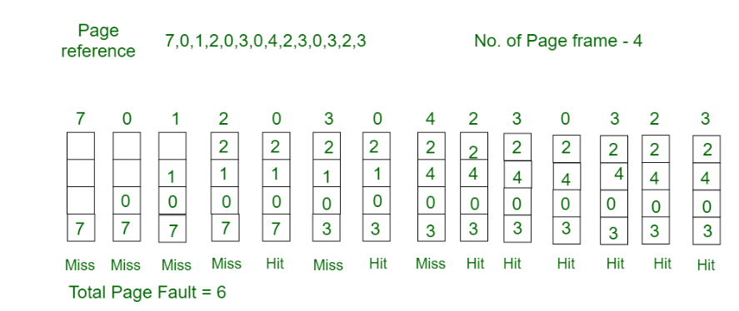
Operating Systems
The Optimal Page Replacement Algorithm
Optimal Page replacement: In this algorithm, pages are replaced which would not be used for the longest duration of time in the future.
Consider the page references 7, 0, 1, 2, 0, 3, 0, 4, 2, 3, 0, 3, 2, 3 with 4 page frame. Find number of page fault.

Slide 7
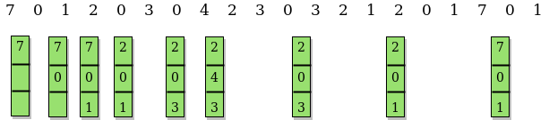
Another example
No of hits = 11
No of miss = total pages - hit

Slide 8
First In First Out (FIFO)
This is the simplest page replacement algorithm. In this algorithm, the operating system keeps track of all pages in the memory in a queue, the oldest page is in the front of the queue. When a page needs to be replaced page in the front of the queue is selected for removal.
Example 1: Consider page reference string 1, 3, 0, 3, 5, 6, 3 with 3 page frames. Find the number of page faults.

Slide 9



